Slide 1
MovieLens Movie Recommendation System
BIA 678
Gaurav Sawant
Dhaval Sawlani
Guided by:
Prof. David belanger

Slide 2
Overview
Goal:
To study different Similarity techniques and collaborative filtering algorithms and see how they scale.
Data Set:
We are using the Movie Lens data sets found on the Group Lens website (grouplens https://grouplens.org/)
Ratings Data: UserId, MovieId, Ratings(1-5), TimeStamp
Movie Data: Movie_ID, Title, Genres

Slide 3
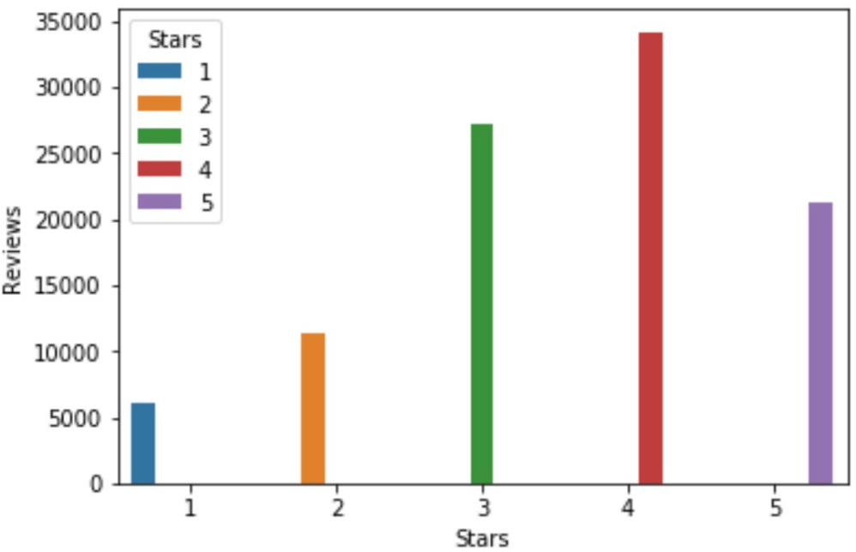
Movie ratings distribution

Slide 4
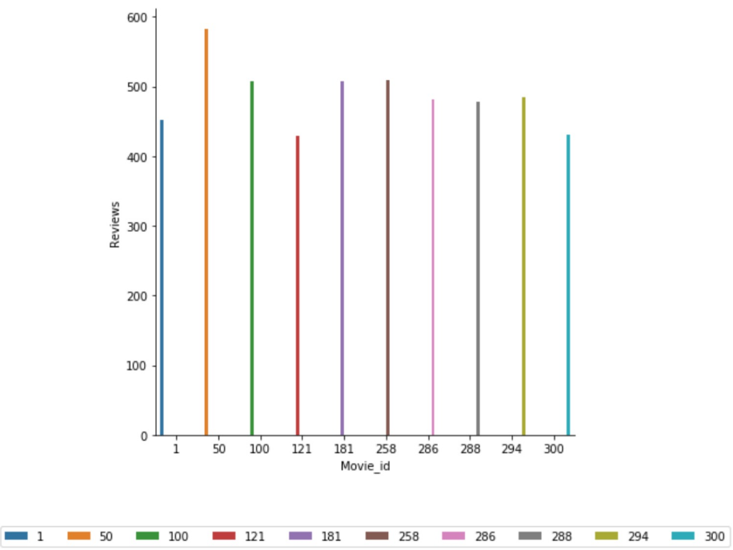
Movie reviews distribution

Slide 5
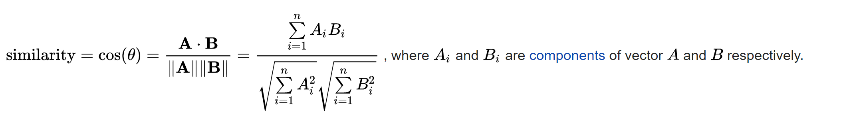
Cosine Similarities
Cosine similarity is the measure of the angle between the vectors of an non-zero space in mathematical terms.
In movie recommendations, it is the measure of the similarity between the movies taking the ratings of the users into account.
Used RDDs and key, value pairs to obtain the cosine similarity of the movies.
Cosine similarity between any two vectors is calculated as follows
Range of 0-1
Closer to 1 means stronger similarity index and vice-versa

Slide 6
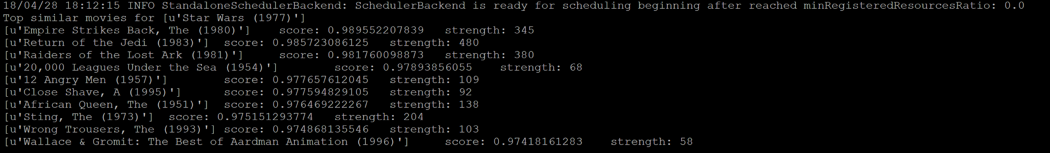
Computing Cosine Similarities
Steps followed:
Created a cartesian join of the data set. (Took maximum time on the cluster and on local)
Filtered duplicates
Group by movieID to obtain all the reviews of that movie in a single (key,value) pair
Computed Cosine similarity.
Filtered Movies with more than 50 reviews and greater than 0.97 score
The results on the cluster where as shown below:

Slide 7
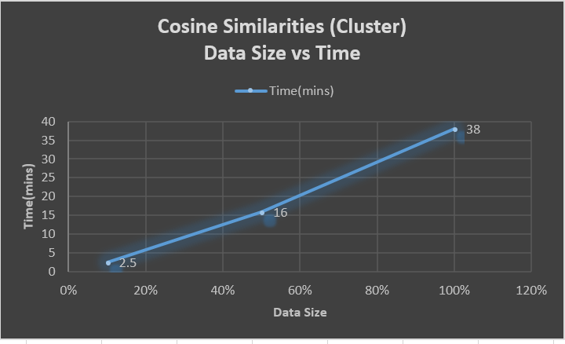
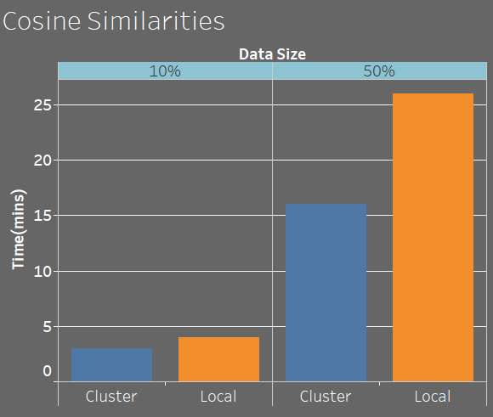
Cosine Similarities Results

Slide 8
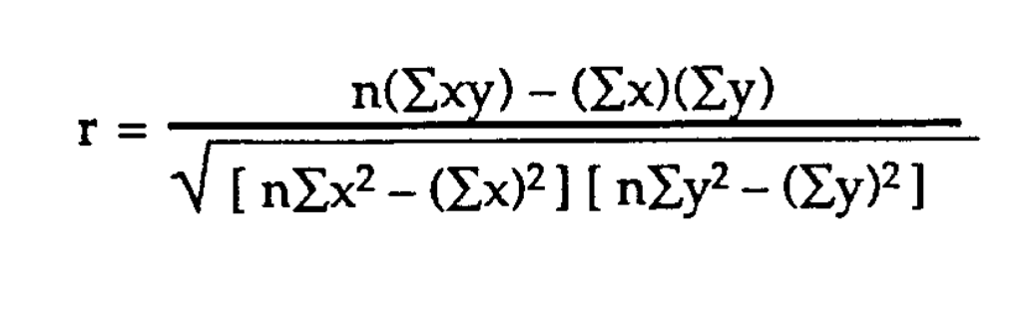
Pearson correlation coefficient (r)
Pearson correlation coefficient also called as bivariate correlation is referred to as Pearson’s r.
It is the measure of linear correlation between two vectors A & B and has a range of -1 to 1, where 1 means total +ve correlation, 0 means no correlation and -1 means total -ve correlation.
Pearson correlation coefficient usually normalizes your similarity index and thus punishes the instances where cosine similarity would fail.
Limitations
Does not explain the relation between dependent and independent variables. This does not matter in our case, because if movie A has an r of 0.8 with movie B and vice-versa exists, we can anyways say movie A and B are similar.

Slide 9
Computing Pearson correlation
Steps followed:
Created a cartesian join of the data set. (Took maximum time on the cluster and on local)
Filtered duplicates
Group by movieID to obtain all the reviews of that movie in a single (key,value) pair
Computed Pearson correlation.
Filtered Movies with more than 50 reviews and greater than 0.5 score
The results on the cluster where as shown below:

Slide 10
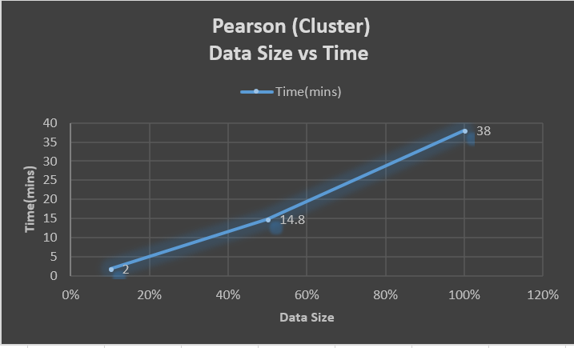
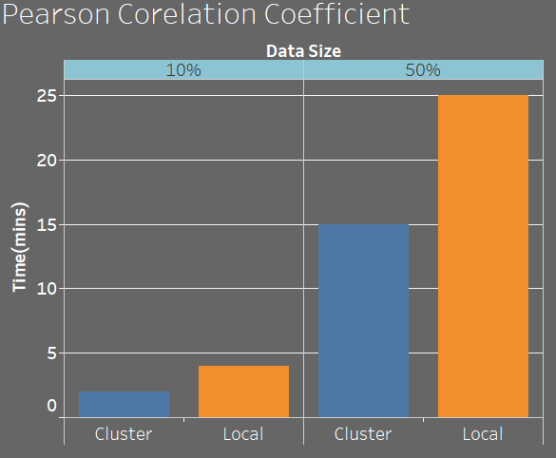
Pearson Correlation Results

Slide 11
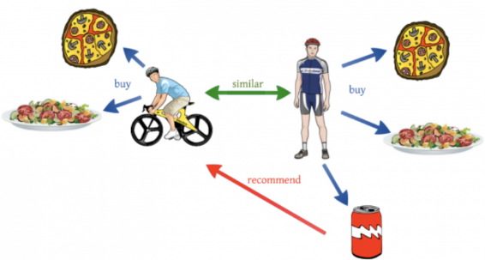
Collaborative Filtering
Collaborative Filtering is based on the idea that people get best recommendations from people with similar tastes
Memory Based CF: Uses user rating data to compute similarity between users/items to make recommendations
Model Based CF: Models are developed using different machine learning algorithms to predict users’ rating of unrated items

Slide 12

Alternating Least Squares(ALS):
Matrix Factorization:
ALS is a popular matrix factorization recommendation system. Matrix Factorization can be shortly explained as follows-
Each user is described by k features or attributes. A feature might be a number how much each user like movies of a particular genre
Each movie can be described as a set of k features. Feature 1 for a movie might be a number how close a movie is to that genre
Finally, multiply the feature of user with the feature of item and add to get and an approximate rating
User u takes form of k-dimensional vector x_u and the item/movie i takes form of k-dimensional vector y_i. The k attributes are called latent factors.
We produce a loss function by minimizing the square of the difference between predictions and ratings

Slide 13
Alternating Least Squares(ALS)
For ALS we hold one set of latent factors constant say item vectors
We then solve for the non-constant vectors
We alternate back and forth until before converging
Steps Followed:
Construct RDDs as per the requirement
Use spark’s mllib library with pyspark to run the ALS algorithm
Compare the RMSE and time results to check scalability

Slide 14
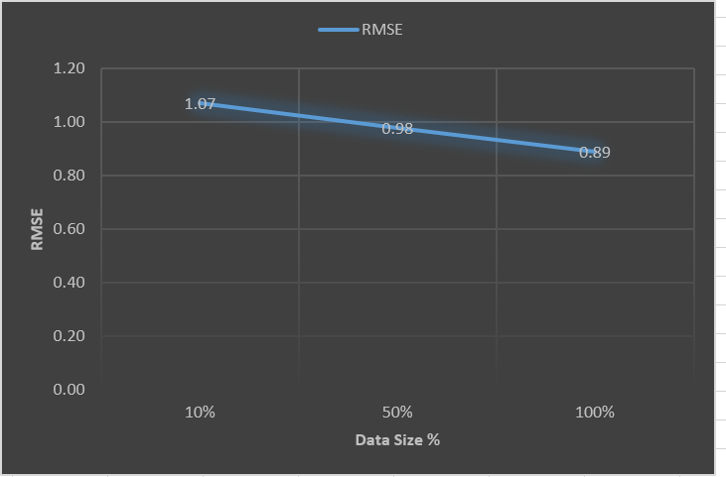
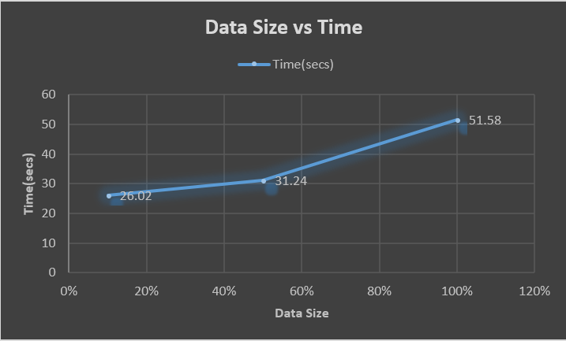
Alternating Least Squares Results
Data Size vs RMSE (Cluster)
Data Size vs Time (Cluster)

Slide 15
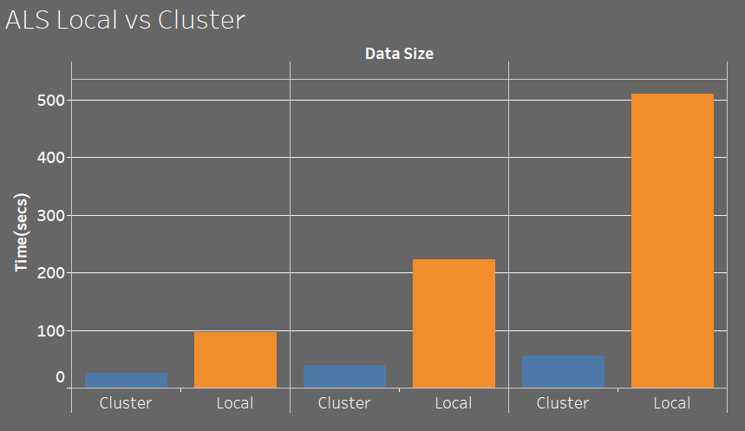
Alternating Least Squares Results (Scalability)

Slide 16
Conclusion & Future Scope
Cosine Similarities and Pearson Coefficient Correlation overall produce similar results. Pearson Coefficient is only slightly better
In ALS, as expected the time taken increases with the size of the data and the RMSE decreases with increase in the size of the data
In all the methods studied, time taken on cluster is considerably less than the time taken on the local machine
Future Scope:
Studying more collaborative filtering techniques and their scalability.
Decrease the RMSE
Impment Hybrid CF techniques and run on larger data sets.

